Slide 1

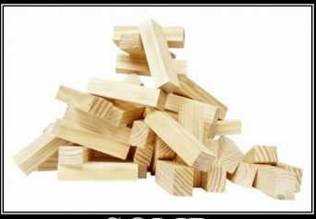
SOLID principles

Slide 2
What is SOLID ?
Robert C. Martin compiled these principles in the 1990s.
Collection of guidelines for object oriented software design.
Five basic principle which help to create good software architecture.
Ways to move from tightly coupled code.
Help in making the object oriented application source code robust, scalable, extensible.
Essential when you have layered architecture and they are bound to change over the period of time.

Slide 3
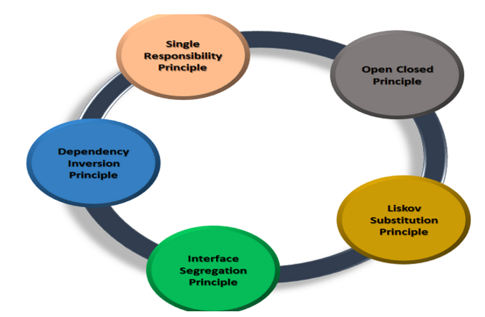
SOLID ….. Five Important Object Oriented Principles
Single responsibility principle (SRP)
Open-Closed principle (OCP)
Liskovs substitution principle (LSP)
Interface segregation principle (ISP)
Dependency inversion principle (DIP)

Slide 4
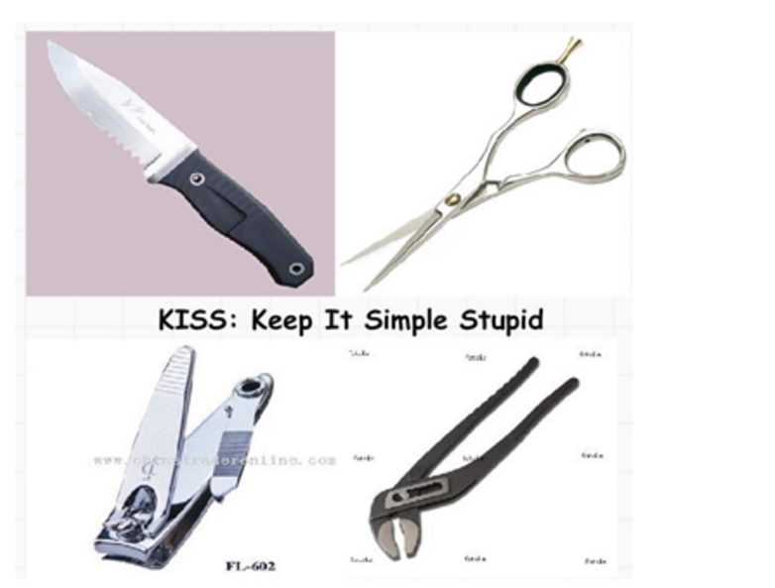
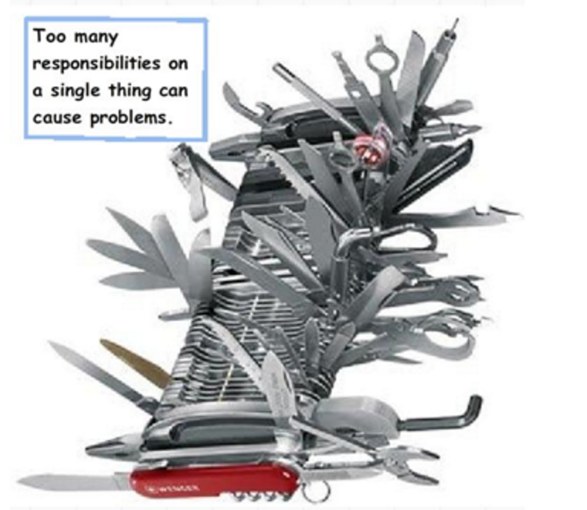
Single Responsibility Principle (SRP)
SRP : Every Class should have a single responsibility and the responsibility should be encapsulated by the class.
SRP Says “ Every Software Module should have only one responsibility to Change”.
In other words, every object should perform only one thing.

Slide 5
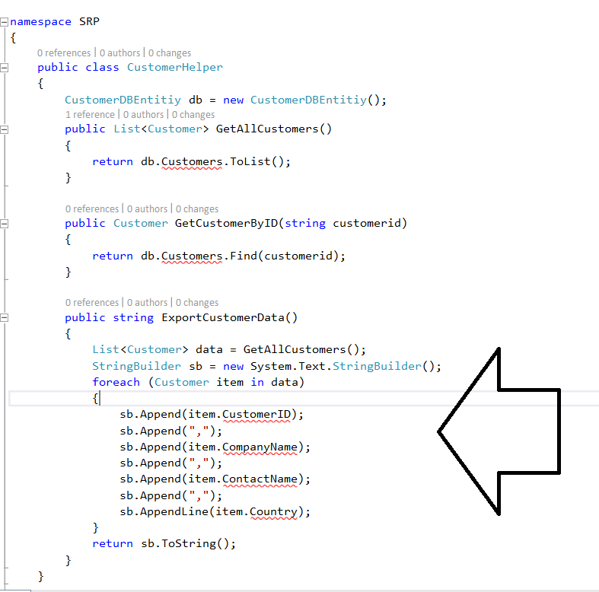
Sample Code Violates SRP

Slide 6
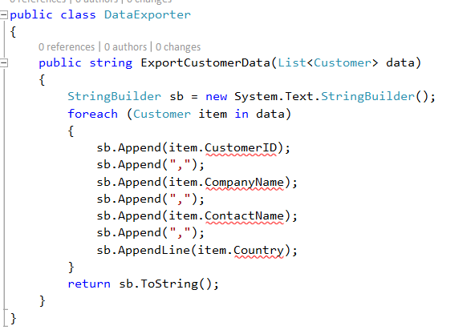
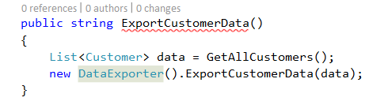
Refactor the code to Fit into SRP

Slide 7
Other Examples Violating SRP
public class Repository<D, T> : IRepository<T> where T : class where D : DbContext, new()
{
D entities = new D();
public void Create(T entity)
{
try
{
entities.Set<T>().Add(entity);
}
catch(Exception ex)
{
File.WriteAllText(@"D:\Error.log", ex.ToString());
}
}
}

Slide 8
Fit the Code base into SRP
Invoke the File Logger inside the Repostory Class
public class Repository<D, T> : IRepository<T> where T : class where D : DbContext, new()
{
D entities = new D();
public void Create(T entity)
{
try
{
entities.Set<T>().Add(entity);
}
catch(Exception ex)
{
new FileLogger().Log(@"D:\Error.log", ex.ToString());
}
}
}
Address logging mechanism into One class.
class FileLogger
{
public string Path
{
get; set;
}
public void Log(string message)
{
File.WriteAllText(Path, message);
}
}

Slide 9
Benefits of SRP code
Reduction in complexity of code.
Increased readability, extensibility and maintenance.
Reusability and reduced errors.
Better testability.
Reduced coupling.

Slide 10
Open Closed Principle (OCP)
In 1988 the open closed principle (OCP) is already mentioned by Bertrand Meyer :
Software should be open for extension, but closed for modification.
“software entities (classes, modules, functions, etc.) should be open for extension, but closed for modification”.
The best way to implement the open closed principle is to first start with implementing the Single Responsibility Principle.
You should design modules that never change. When requirements change, you extend the behaviour of such modules by adding new code, not by changing old code that already works.
Abstraction is the way to realize this principle. Derivatives from an abstraction are closed for modification because the abstraction is fixed but behaviour can be extended by creating new derivatives of the abstraction.

Slide 11
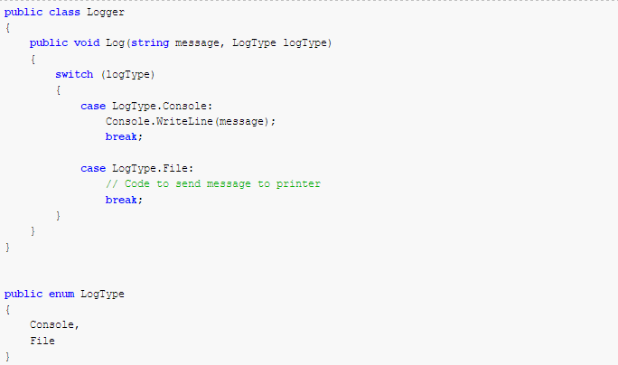
The Class Violates the OCP and Meets SRP

Slide 12
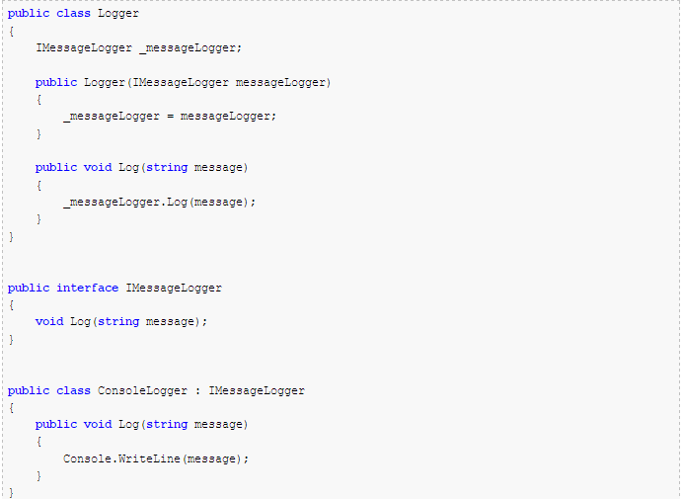
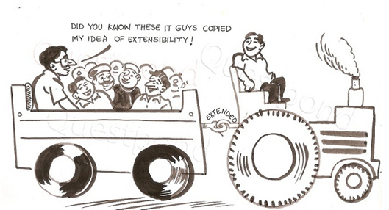
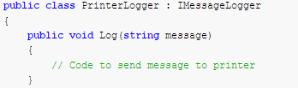
Refactor the Class to meet the OCP

Slide 13
Liskov’s Substitution Principle
The concept of this principle was introduced by Barbara Liskov in a 1987
LSP states that the derived classes should be perfectly substitutable for their base classes.
child class should be substitutable to parent class.
We must make sure that new derived classes are extending the base classes without changing their behavior.
This pattern states that functions that use pointers or references to base classes must be able to use objects of derived classes without knowing it

Slide 14
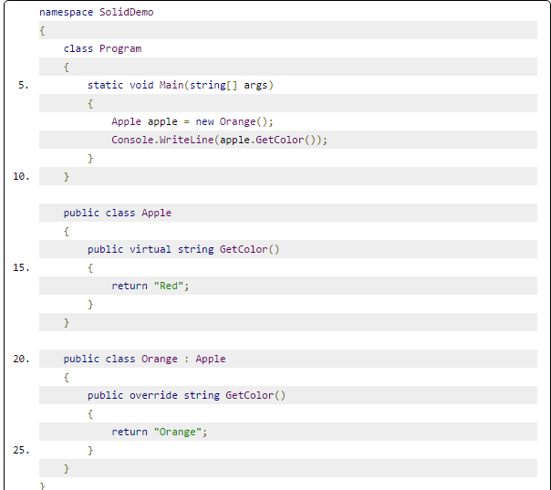
The code base violates LSP

Slide 15
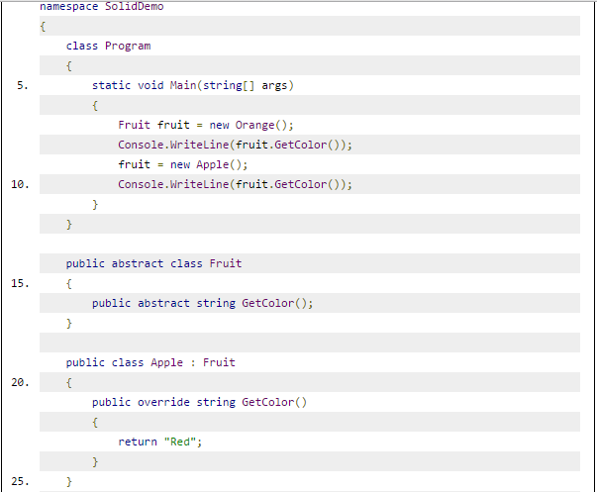
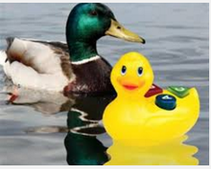
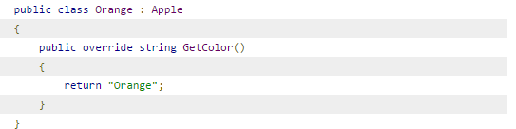
Fix the Code with LSP

Slide 16
Interface Segregation Principle
The ISP was first used and formulated by Robert C. Martin.
The principle states that no client should be forced to depend on methods that it does not use.
ISP is about breaking down big fat master-interfaces to more specialized and cohesive ones that group related functionality.
What the ISP is trying to correct is the injection of so much functionality into a single class that you end up with impacting the internal code causing the class to have to implement changes that override the original purpose of the class.
ISP splits interfaces which are very large into smaller and more specific ones so that clients will only have to know about the methods that are of interest to them.
ISP is focused on the idea of each interface representing one discrete and cohesive behavior.

Slide 17
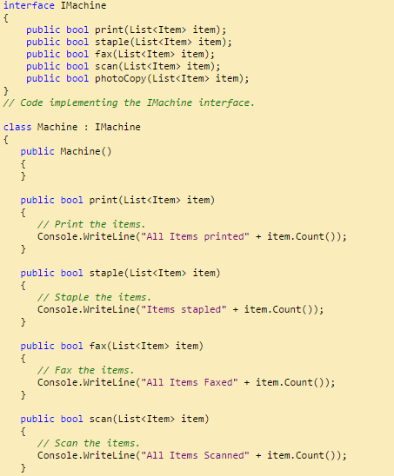

The Code violates the ISP
Potential Problems
Supply the interface to a client who is just interested in Print Job ??
Why are you forcing your printer client to implement scanning functionality even when they don't want it?

Slide 18
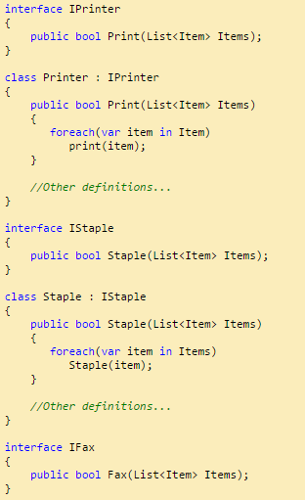
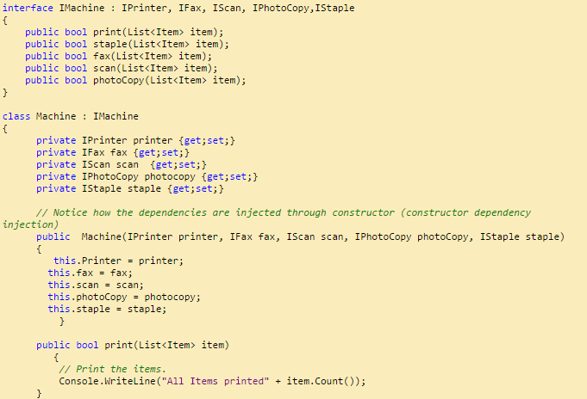
Fix the ISP issue
or

Slide 19
Dependency Inversion
This principle was defined by Robert C. Martin.
High-level modules should not depend on low-level modules. Both should depend on abstractions
Abstractions should not depend upon details. Details should depend upon abstractions
The Dependency Inversion Principle (DIP) helps to decouple your code by ensuring that you depend on abstractions rather than concrete implementations.
Effectively, the DIP reduces coupling between different pieces of code.
Since objects are created by injection, preferably using interfaces, it's easy to create unit tests that replace dependencies with mock versions

Slide 20
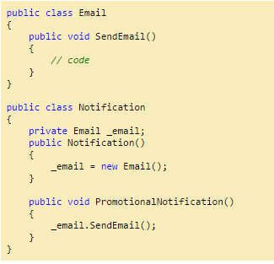
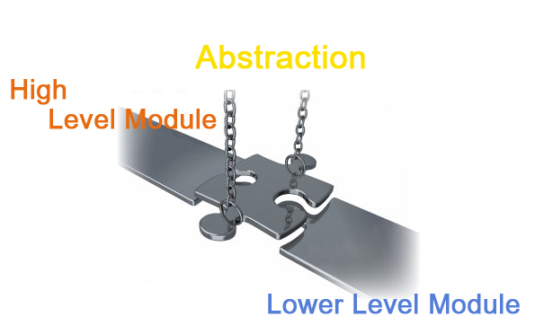
The code violates the DI principle
Notification Class is dependent on Email Class.
The Notification class creates the Instance of the Email Class directly inside the Notification Constructor.
A class has dependency on some other class and knows a lot about the other classes it interacts with is said to be tightly coupled.

Slide 21
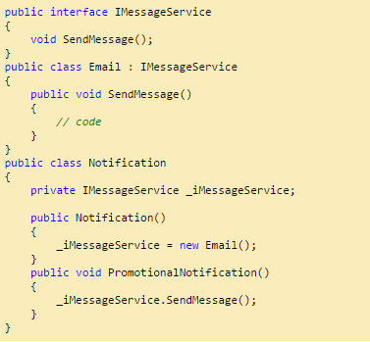
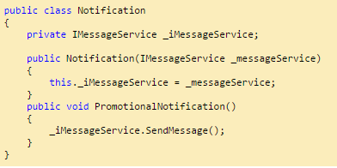
How to Fix through DI ?
DI Injection
Constructor Injection.
Property Injection.
Method Injection.

Slide 22


